Slide 1
Design your Cloud application: design principles
Ashvini Shahane

Slide 2
Agenda
Design and Architecture Lifecycle
Technology choices for compute and data services
Design principles for building scalable, available, resilient applications on the cloud

Slide 3
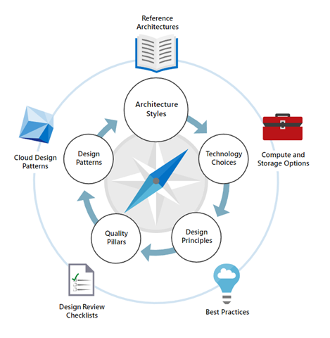
Design and Architecting cycle

Slide 4
Technology Choices

Slide 5
Microsoft Azure Compute Choices
App Service | A managed service for hosting web apps, mobile app back ends, RESTful APIs, or automated business processes
Azure Kubernetes Service (AKS) | A managed Kubernetes service for running containerized applications.
Batch | A managed service for running large-scale parallel and high-performance computing (HPC) applications
Container Instances | The fastest and simplest way to run a container in Azure, without having to provision any virtual machines and without having to adopt a higher-level service.
Functions | A managed FaaS service. Provides serverless compute option on Azure
Service Fabric | A distributed systems platform that can run in many environments, including Azure or on premises
Virtual machines | Deploy and manage VMs inside an Azure virtual network

Slide 6
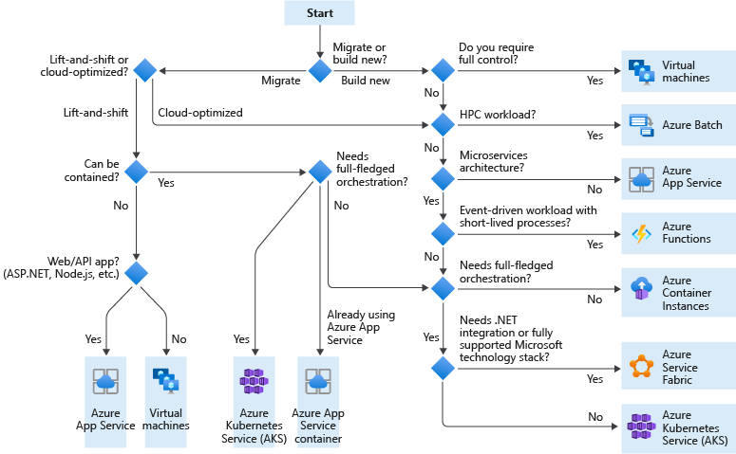
Choosing the Azure compute service option for your application

Slide 7
Data Categories
Structured data | Semi-structured data | Unstructured data
Adhere to a schema, with same data fields or properties. | Ad hoc schema. Less organized fields and properties than structured data. | No designated schema or data structure.
Storable in relational database tables, with rows and columns. | Non-relational or NoSQL data, not storable in tables, rows and columns. | Non-relational or blob data, with no restrictions on kinds of data blobs contain.
Examples include, sensor or financial data. | Books, blogs, and HTML documents are examples of semi-structured data. | For example, a blob can hold a PDF, JPG, JSON object, or video.
Notes:
This slide intends to:
help students understand how data are structured and classified
explain why different storage services exist
illustrate how storage services are used
map data structures to corresponding storage services

Slide 8




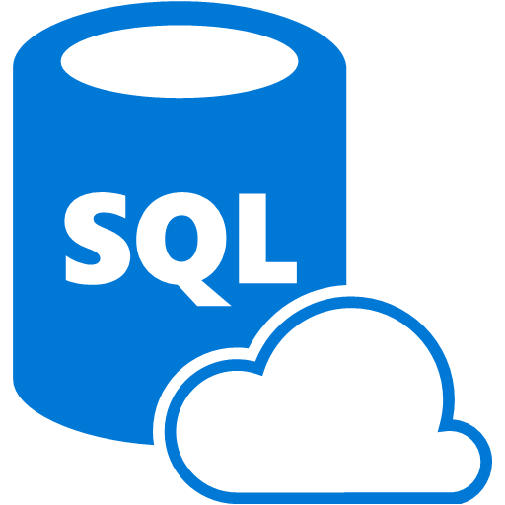
Azure Data Platform technologies
When you need a low cost, high throughput data store
When you need to store No-SQL data
When you do not need to query the data directly. No ad hoc query support
Suits the storage of archive or relatively static data
Suits acting as a HDInsight Hadoop data store
Storage Account
When you need a low cost, high throughput data store
Unlimited storage for No-SQL data
When you do not need to query the data directly. No ad hoc query support
Suits the storage of archive or relatively static data
Suits acting as a Databricks , HDInsight and IoT data store
Data Lake Store
When you require an integrated relational and big data store
When you need to manage data warehouse and analytical workloads
When you need low cost storage
When you require the ability to pause and restart the compute
When you require a solution that can scale elastically
Azure Synapse
Analytics
Provides global distribution for both structured and unstructured data stores
Millisecond query response time
99.999% availability of data
Worldwide elastic scale of both the storage and throughput
Multiple consistency levels to control data integrity with concurrency
Azure COSMOS DB
When you require a relational data store
When you need to manage transactional workloads
When you need to manage a high volume on inserts and reads
When you need a service that requires high concurrency
When you require a solution that can scale elastically
Supports multiple data platforms – MySQL, PostgreSQL, MariaDB
Azure SQL Database
Notes:
Taking points
This slide is optional and should be used at the trainer's discretion.
You may have students who have general question about the different technologies on Azure. This slide can be used to support answering such questions

Slide 9



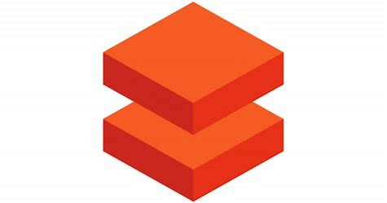
Azure Data Platform technologies (continued)
When you require a fully managed event processing engine
When you require temporal analysis of streaming data
Support for analyzing IoT streaming data
Support for analyzing application data through Event Hubs
Ease of use with a Stream Analytics Query Language
Azure Stream Analytics
When you want to orchestrate the batch movement of data
When you want to connect to wide range of data platforms
When you want to transform or enrich the data in movement
When you want to integrate with SSIS packages
Enables verbose logging of data processing activities
Azure Data Factory
When you need a low cost, high throughput data store
When you need to store No-SQL data
Provides a Hadoop Platform as a Service approach
Suits acting as a Hadoop, Hbase, Storm or Kafka data store
Eases the deployment and management of clusters
Azure HDInsight
Eases the deployment of a Spark based cluster
Enables the fastest processing of Machine Learning solutions
Enables collaboration between data engineers and data scientists
Provides tight enterprise security integration with Azure Active Directory
Integration with other Azure Services and Power BI
Azure Databricks
Notes:
Talking points
This slide is optional and should be used at the trainer's discretion.
You may have students who have general question about the different technologies on Azure. This slide can be used to support answering such questions

Slide 10
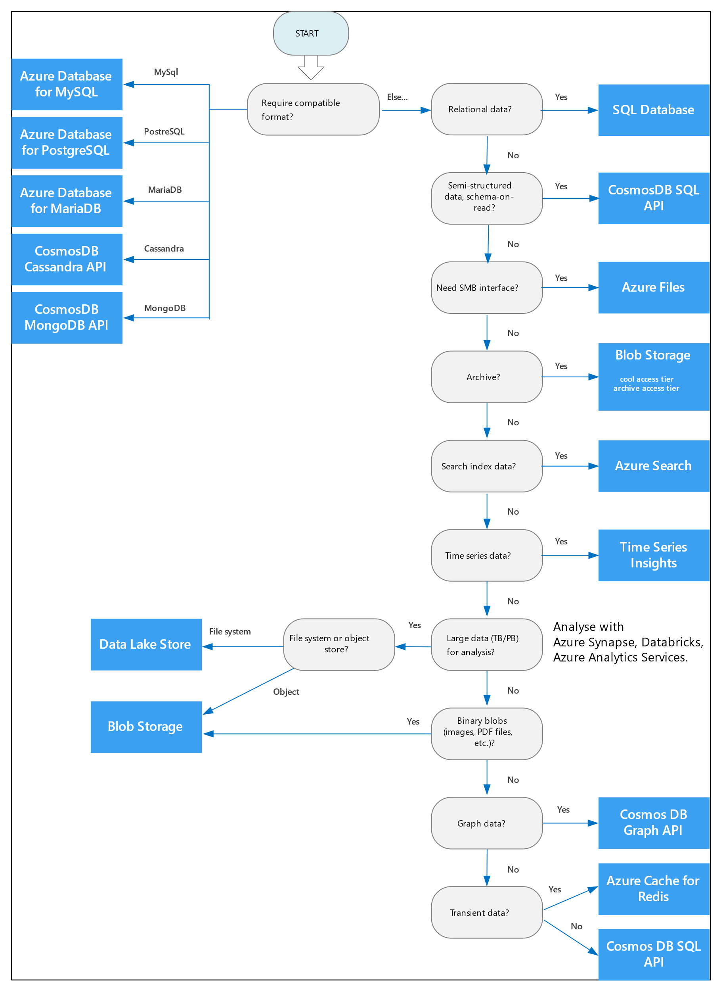
Choosing the Azure Data Store for your application

Slide 11
Choosing the Azure Data Store for your application

Slide 12







Design and Architect Cloud Application
Migrating existing on premise application to cloud
Building a new Cloud Native application
Remain
7 R considerations to Migration
Rehost
Design Principles for Cloud Applications
Refactor
Best Practices for Building Cloud Ready or Cloud Native Applications
that are resilient, scalable, available, manageable
Rearchitect
Rebuild
Replace
Retire

Slide 13
Design Principles

Slide 14
Take advantage of the benefits that the cloud brings – Hyper scale
Think Adaptive and Elastic

Slide 15
Think Adaptive and Elastic
Cloud has the benefit of providing hyper scale and elastic
Scaling can be
Vertical Scaling – Requires downtime
Horizontal Scaling – Seamlessly scale as per requirement

Slide 16
Make your application scalable
Avoid storing state in the application components, make them stateless
Avoid sticky sessions – make them stateless
Identify and divide application into workloads that can be scaled as per its requirements
Don’t forget to scale in!!!
Critical components – scale aggressively!
Where ever possible automate scaling
Application instrumentation to capture key metrics
Testing, monitoring and tuning auto scaling strategy is critical

Slide 17
Compute services that support Auto Scale
Azure Virtual Machine ScaleSets
Azure App Services
Azure Kubernetes Services
Azure Service Fabric
Azure Functions – Supports serverless also…
Notes:
Azure Virtual Machines autoscale via virtual machine scale sets, which manage a set of Azure virtual machines as a group. See How to use automatic scaling and virtual machine scale sets.
Service Fabric also supports autoscaling through virtual machine scale sets. Every node type in a Service Fabric cluster is set up as a separate virtual machine scale set. That way, each node type can be scaled in or out independently. See Scale a Service Fabric cluster in or out using autoscale rules.
Azure App Service has built-in autoscaling. Autoscale settings apply to all of the apps within an App Service. See Scale instance count manually or automatically.
Azure Cloud Services has built-in autoscaling at the role level. See How to configure auto scaling for a Cloud Service in the portal.

Slide 18
Scaling data solutions
Traditional data solutions – relational databases
Built for Vertical scaling
Restricted by service limits
Need to implement Partitioning strategy to scale further
Some data services are built for scaling out
Modern distributed data sources like NoSQL data sources are built for scale out strategy
Data is partitioned by default and can be distributed
Work on Eventual consistency model
Most suited for modern cloud applications

Slide 19
Data Partitioning Benefits
Improve scalability
Improve performance
Improve availability
Improved security implementation

Slide 20
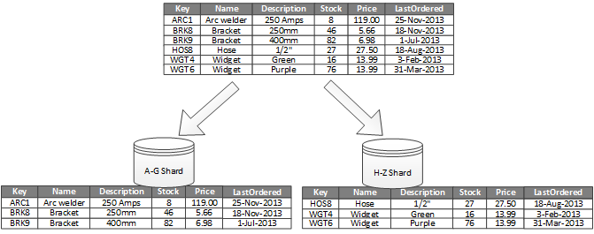
Data Partitioning Strategy – Horizontal Partitioning
All partitions have same schema
Partitions are called Shards
Each shard holds subset of the data

Slide 21
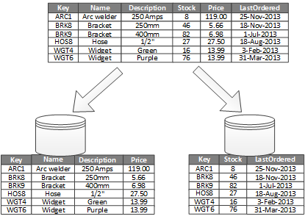
Data Partitioning Strategy – Vertical Partitioning
Each partition holds subset of fields
Items are partitioned by Fields based on usage pattern

Slide 22
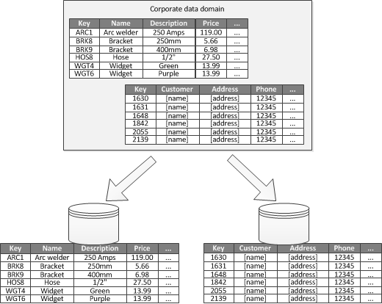
Data Partitioning Strategy – Functional Partitioning
Data partitioned based on business context
Improves isolation and data access performance
Can also be used to separate read data from read-write data

Slide 23
Minimize coordination between application components
Design loose coupling between components

Slide 24
Minimize coordination
Avoid hard dependency between application components and on infrastructure platform
Failure in one component should not affect others
Use asynchronous processing – Queues
Data partitioning
Data Caching
Use optimistic concurrency
Embrace Eventual consistency
Treat servers as disposable resources

Slide 25
Data is at the core of all Solutions
Improve performance and scalability
Adopt polyglot persistence

Slide 26
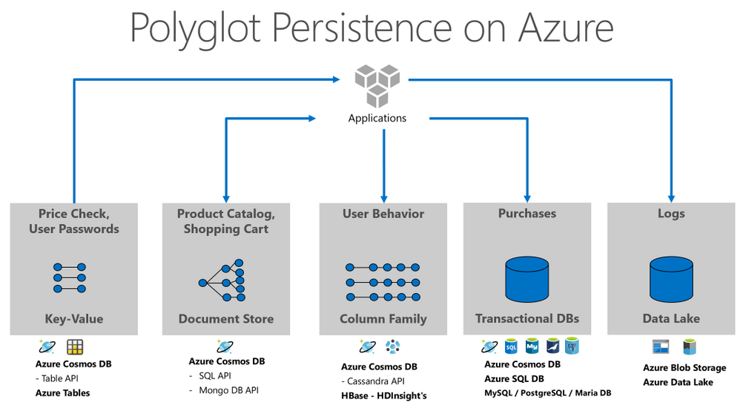
Polyglot Persistence Selecting the right data storage solution for the right functionality

Slide 27
Example: E-Commerce Application
Product Catalog – Document based database
Search for products – ElasticSearch
Add product to cart – Cache
Checkout purchase – Transactions in Relational Database

Slide 28
Build for resiliency and high availability

Slide 29
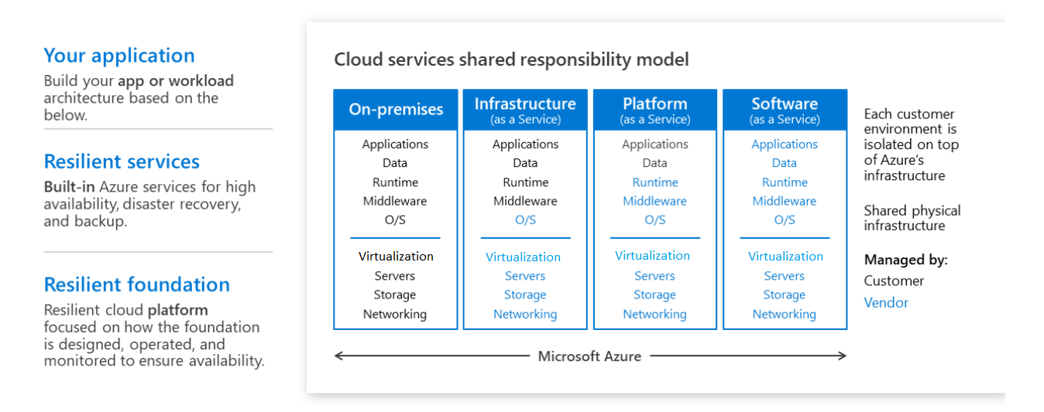
In the cloud - Building systems that survive failure is a Shared Responsibility
Notes:
Azure invests in platform resilience and complements those investments with the abovementioned offerings to ensure uptime for customers. Being resilient in the event of any failure, however, is a shared responsibility. Who’s responsible for what, in terms of resilience, depends on the cloud service model that’s being used—IaaS, PaaS, or SaaS
In the traditional on-premises model, the entire responsibility of managing—from the hardware for compute, storage, and networking to the application—falls on the customer. That requires planning for various types of failures and knowing how to deal with them on-premises. With IaaS, Azure is responsible for the core infrastructure resilience, which includes storage, networking, and compute. As the model moves from IaaS to PaaS and then to SaaS, the customer is responsible for less and the cloud service provider is responsible for more.

Slide 30
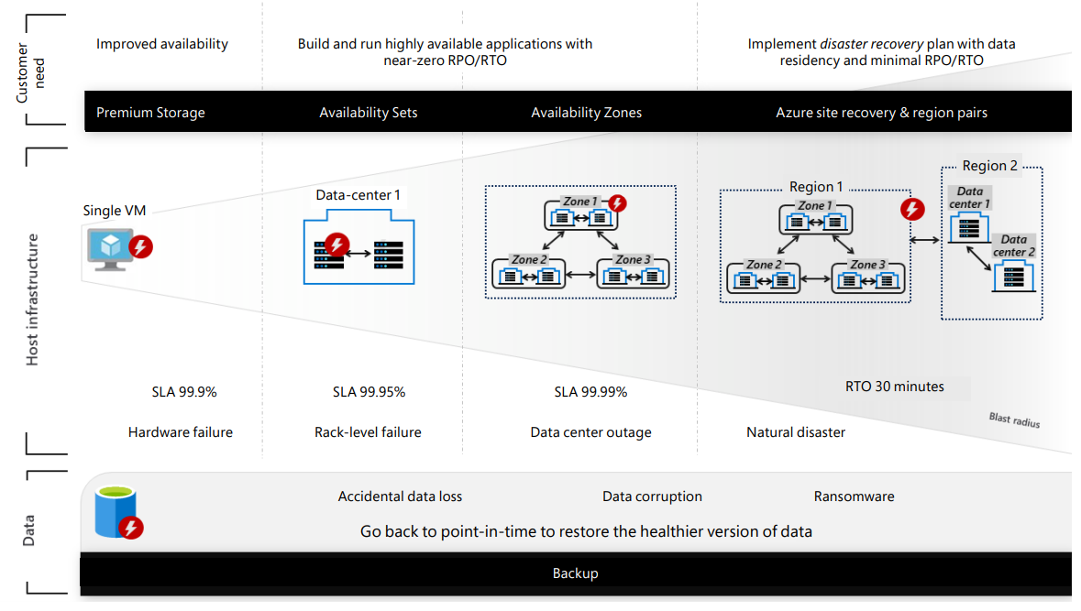
Azure Resilient Services
Notes:
To help protect against the consequences of such failures, Azure provides a comprehensive set of built-in resilience services that customers can easily enable and control based on individual business needs. Whether it’s a single hardware node failure, a rack level failure, a datacenter outage, or a large-scale regional outage, Azure offers solutions

Slide 31
Make all application components redundant
Azure services have built in high availability for services like Compute, storage, SQL Database
Multiple compute instances behind load balancer
Use local or regional or geo replication for data services
Detect and remove SPOF

Slide 32
Make applications Self-Healing
Enable application to recover from failures and continue to function
Application must respond to failures in a way that minimizes downtime or data loss
If recovery not possible, degrade gracefully
Apply patterns to build resiliency
Circuit Breaker
Bulkhead
Compensating transactions
Test for failure
Fault Injection
Load Testing
Build and test DR strategy for application

Slide 33
Build for Operations and Management
Focus on services not servers!
Automate, Automate, Automate!

Slide 34
Focus on Services and not Servers
Adopt PaaS services where ever possible
Managed services reduce operational overheads
Platform provided SLAs
Easier to manage
Think serverless!!

Slide 35
Automate, Automate, Automate!!
Manual deployments are prone to error
Recommended to have an automated, idempotent deployment process that you can run on demand and re-run if something fails.
Options for resilient deployment
Infrastructure as code – use deployment templates
Immutable and configurable infrastructure using configuration agents
Enable collection of logs and metrics and automate for alerts

Slide 36
Only one thing is constant change!
Design for change and evolution

Slide 37
Design for change and evolution
Adapt to business requirement change
Contract based services – plug and play
Cohesive and loosely coupled services
Encapsulate domain knowledge in services
Use open interfaces like REST
Implement cross-cutting concerns in separate services

Slide 38
Meeting business requirements is most critical

Slide 39
Meeting the business needs
Business continuity needs
Define SLAs for the application
Consider Domain driven design
Address both Functional and Non-functional requirements
Define workload-wise strategies for availability, scalability, performance
Optimise for Cost
Plan for growth

Slide 40
Best practices at a glance
Think Adaptive and Elastic
Design for scale
Minimise co-ordination
Data is at the core of all Solutions
Make all components redundant
Make applications Self-Healing
Focus on services not servers!
Automate, Automate, Automate!
Design for change and evolution
Design to meet business requirements

Slide 41
Q&A

